Slide 1






National Government
Provide funds from Grants / Loans
Empower & Fund
MOH
Align and Coordinate
Development
Partners
…
Empower & Fund
Digital Health Department
Govern
& Test
Operate
PMO
PM
PM
PM
PM
Digital Health Project
Digital Health Project
Digital Health Project
Digital Health Project

Slide 2




Aggregated
Person-centric Data
Health Management Information System
Web Form
Shared Health Record Repository
EMR
Person-centric
Data
Batch-aggregated
Person-centric Data
100%
EMR
HMIS
Traffic
Automatically De-identified
Person-centric Data
0%
Time

Slide 3
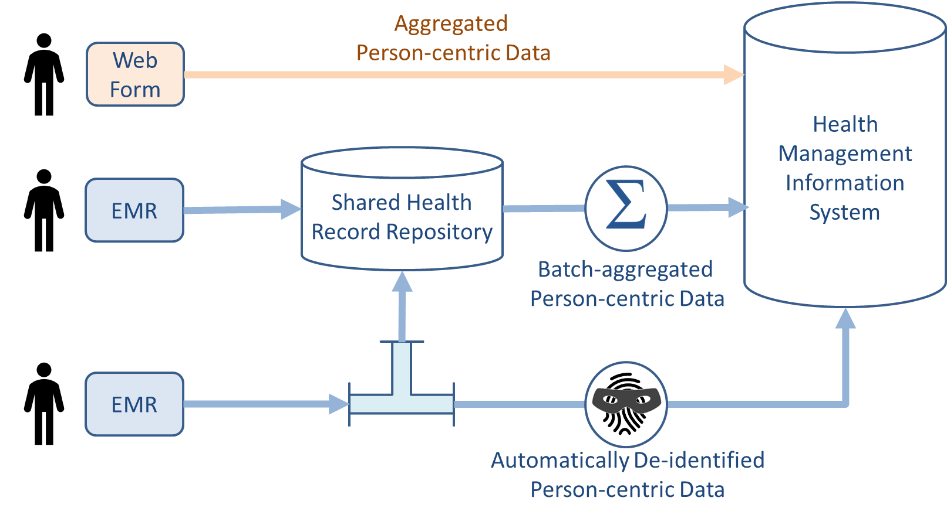
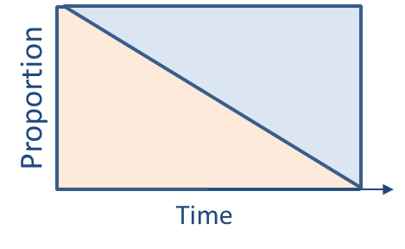

Slide 4

Transactions
ORG
6
Add or update a patient demographic record [ITI-93]
Query for a patient demographic record [ITI-78]
Add or update person-centric health data [ITI-65, PCC-IPS]
Query for person-centric health data [ITI-68, PCC-IPS, PCC-64]
Query for registry content [ITI-90]:
Facility
Health Worker
Organization
Health Service
…or combinations of these
Refresh registries from underlying (federated) directories [ITI-91]
Submit aggregate data report [QRPH-53, QRPH-58*]
Lookup/validate codes [ITI-98, ITI-99]
Translate between codes [ITI-100, ITI-101]
$Apply care plan definition [PCC-69]
FD
HWD
6
6
Interoperability Layer
6
6
HMIS
ILR
CR
SHR
TS
7
5
1
2
3
4
8
9
1
2
3
4
5
7
Real-time transactions
3
POS
8
CCG Engine
Periodic / maintenance transactions
10
9

Slide 5






HWD
FD
ORG
Interoperability Layer
(16)
(16)
(16)
(16)
OLTP FHIR Server
(2)
TS*
(5)
ILR/TS
ILR-HWR
ILR-FR
ILR-ORG
SHR
HMIS
CR*
CR
(7)
(10)
(11,12,13,14)
(10)
(10)
(10)
(8)
(9)
(9*)
(15)
(7)
ATNA
(8)
(9)
(10)
(11,12,13,14)
(15)
(1)
(3)
(4)
(Maintenance/batch transactions)
(Real-time runtime transactions)
CR*
POS
(6)
POS
Solution
(9)
CCG
Engine
(17)

Slide 6

Legacy Solutions
with FHIR-conformant wrappers
ORG
Interoperability Layer
(16)
(16)
(16)
(16)
OLTP FHIR Server
(2)
TS*
(5)
ILR/TS
ILR-HWR
ILR-FR
ILR-ORG
SHR
HMIS
CR*
CR
(7)
(10)
(11,12,13,14)
(10)
(10)
(10)
(8)
(9)
(9*)
(15)
(7)
ATNA
(8)
(9)
(10)
(11,12,13,14)
(15)
(1)
(3)
(4)
(Maintenance/batch transactions)
(Real-time runtime transactions)
CR*
POS
(6)
POS
Solution
(9)
CCG
Engine
(17)

Slide 7
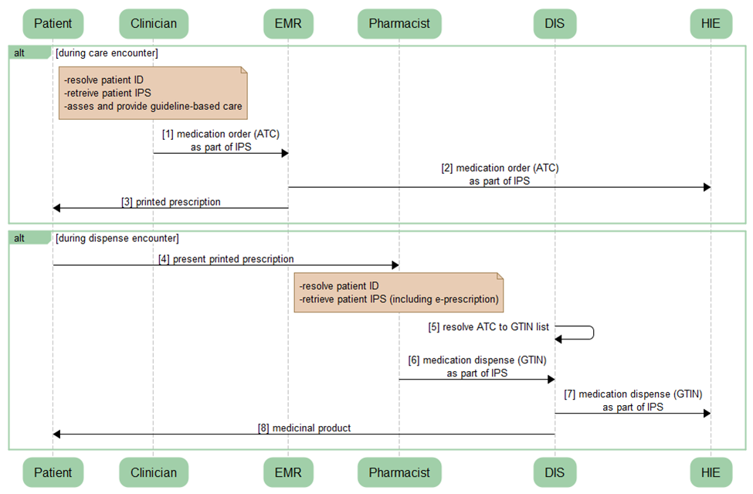

Slide 8
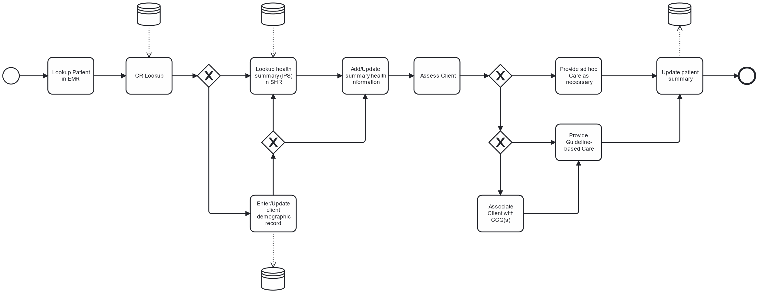
HIE
HIE
HIE
ITI-65
Encounter
IPS
7
8
ITI-67
ITI-68, IPS
9
ITI-78
Ad hoc
encounter
Encounter
Start
Encounter
End
Patient ID not found
or edits needed
existing ID
edited
New ID
created
Guideline-based
encounter
CCG Available
3
4
ITI-93
HIE

Slide 9
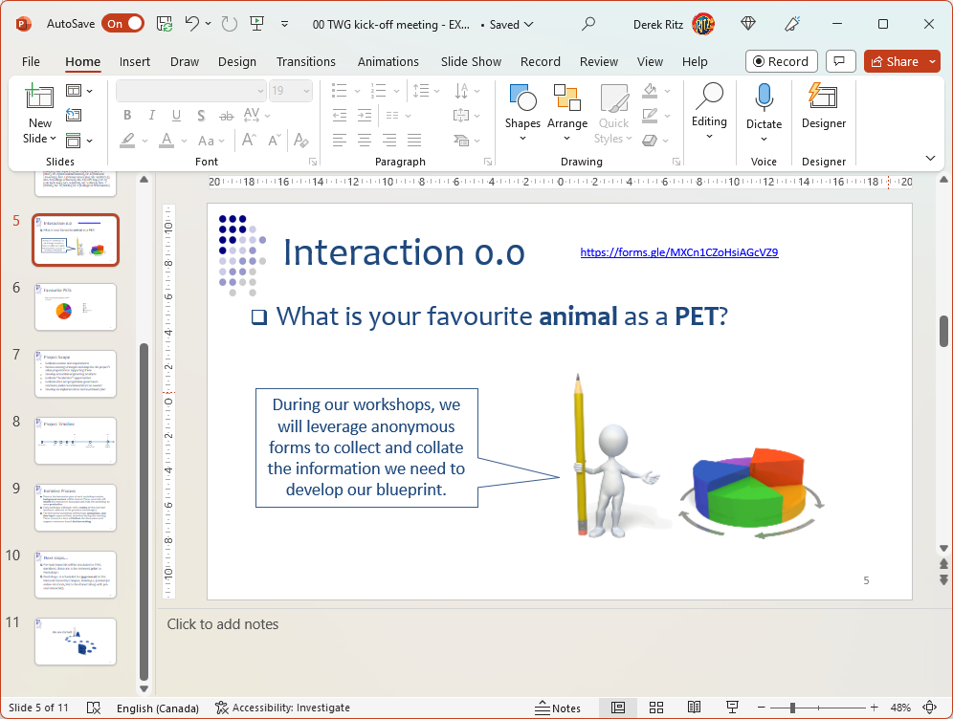


Slide 10
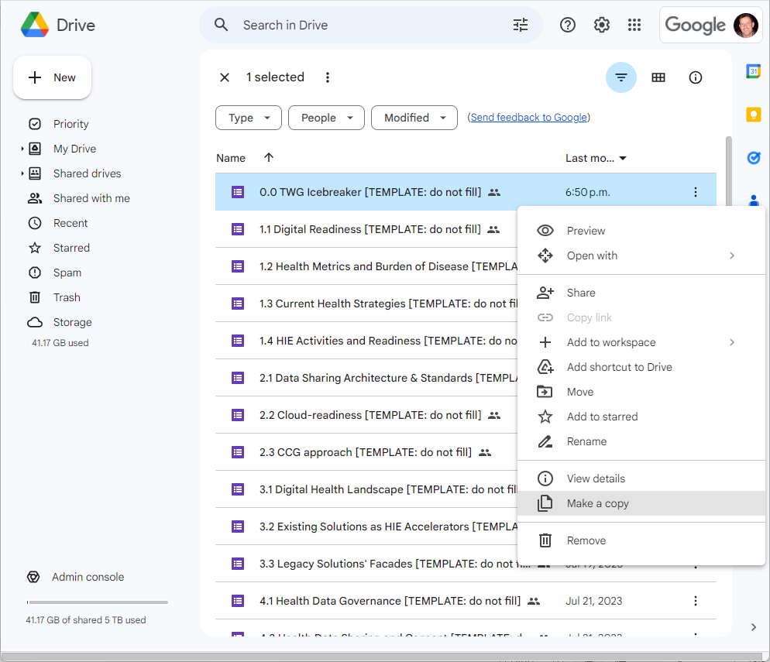

Slide 11
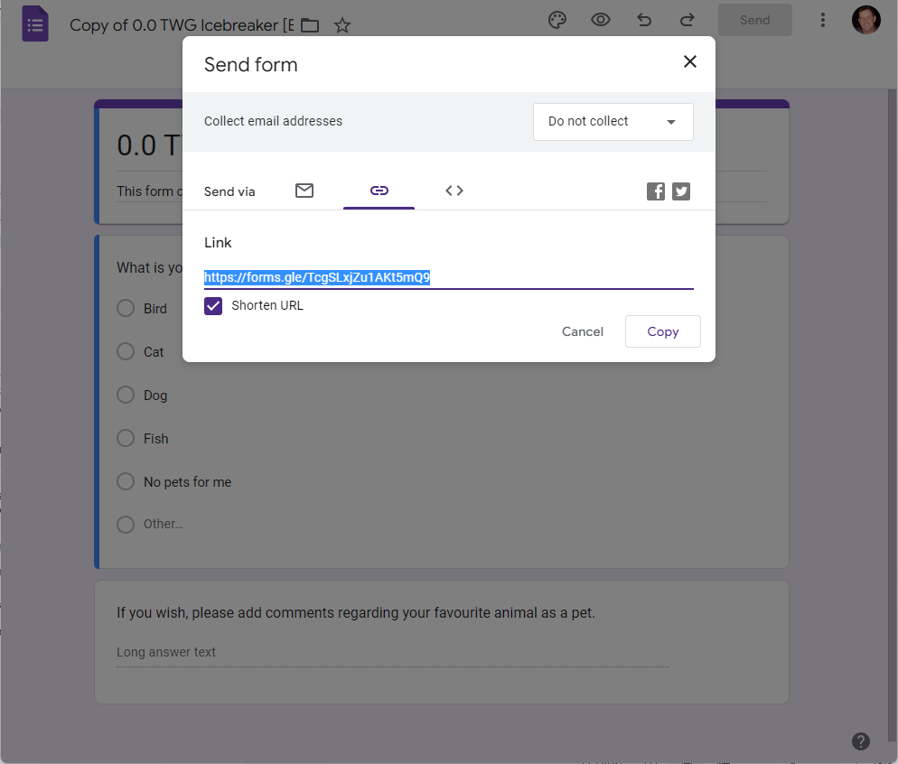

Slide 12
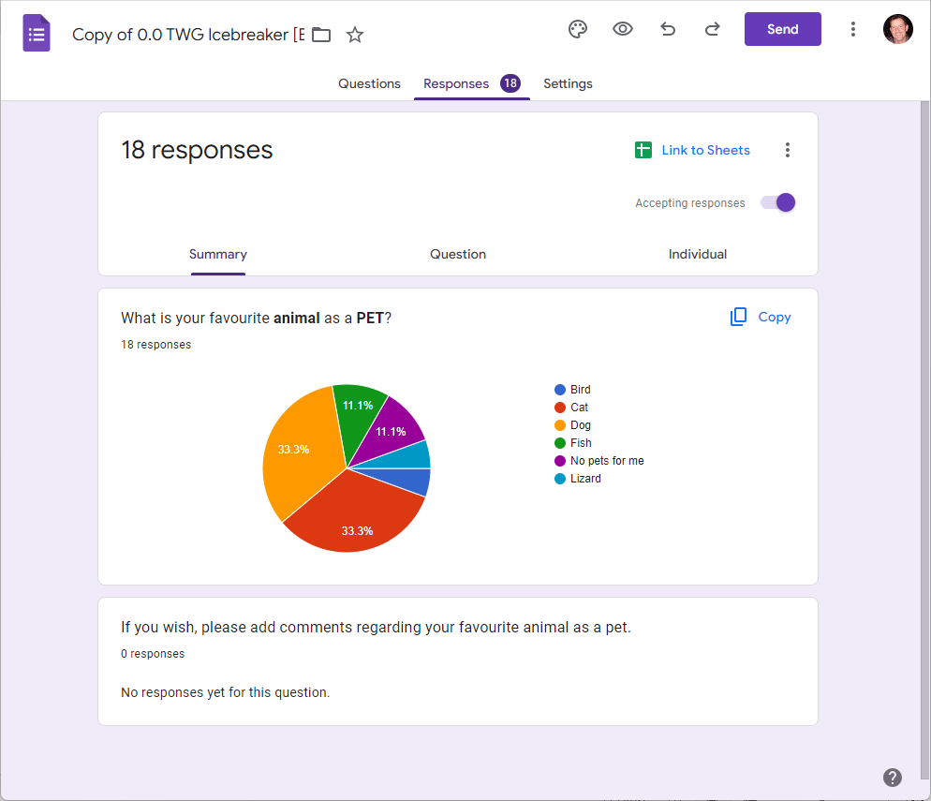

Slide 13
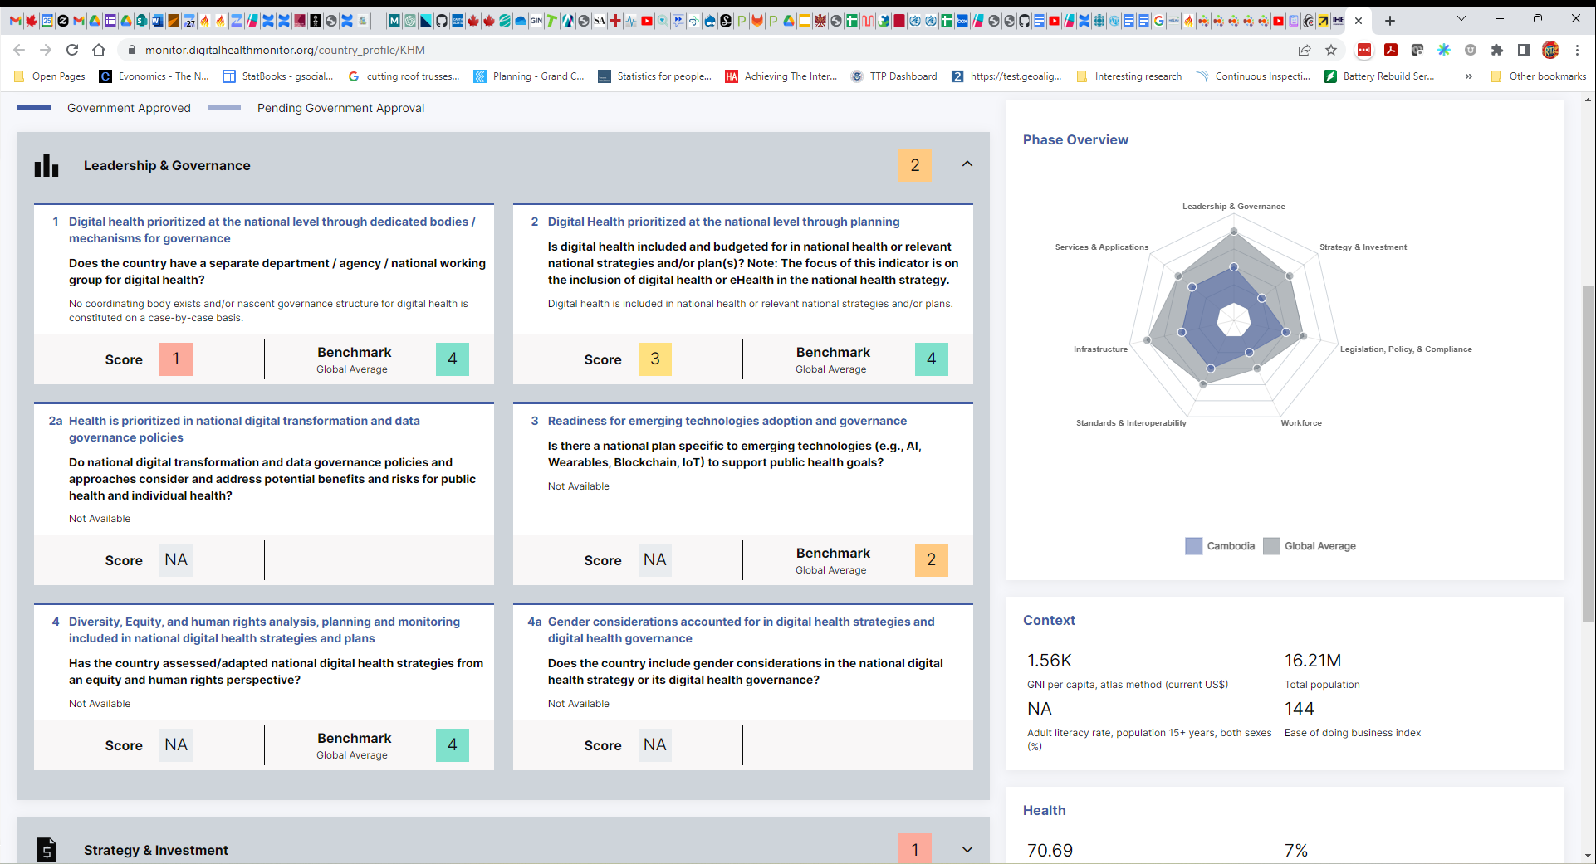

Slide 14
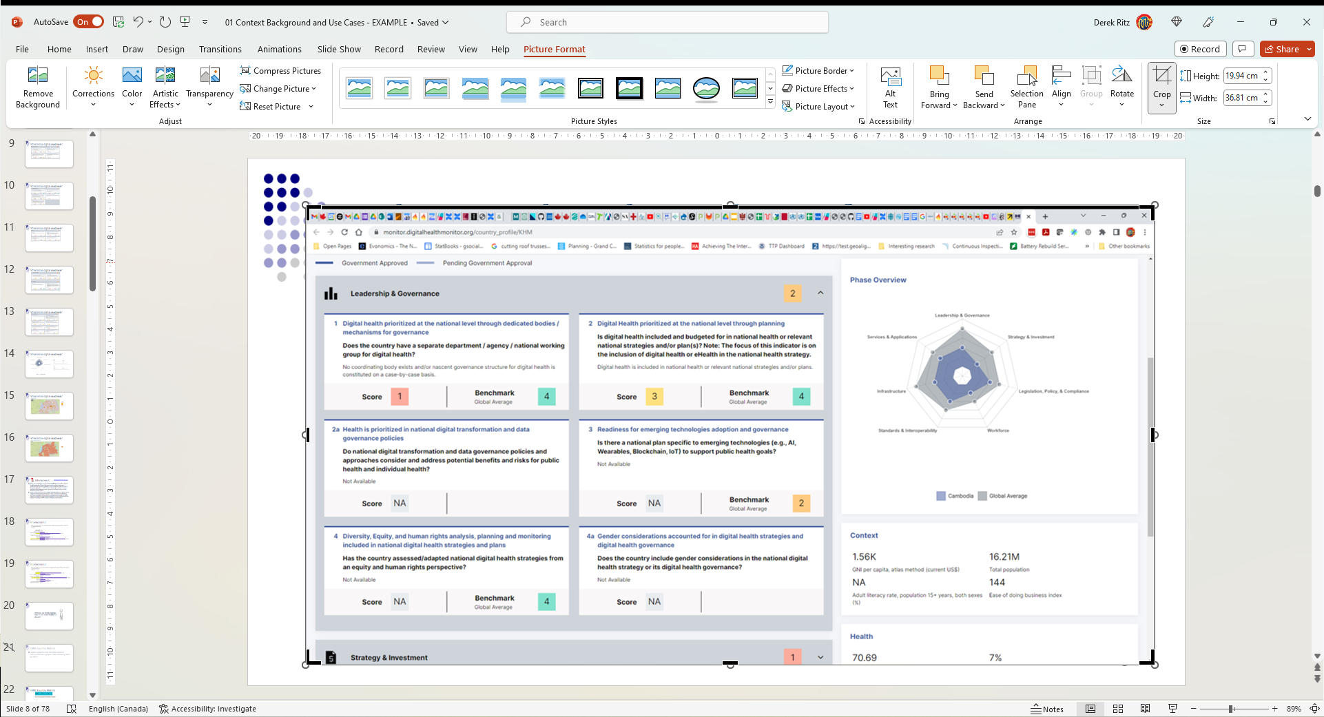

Slide 15
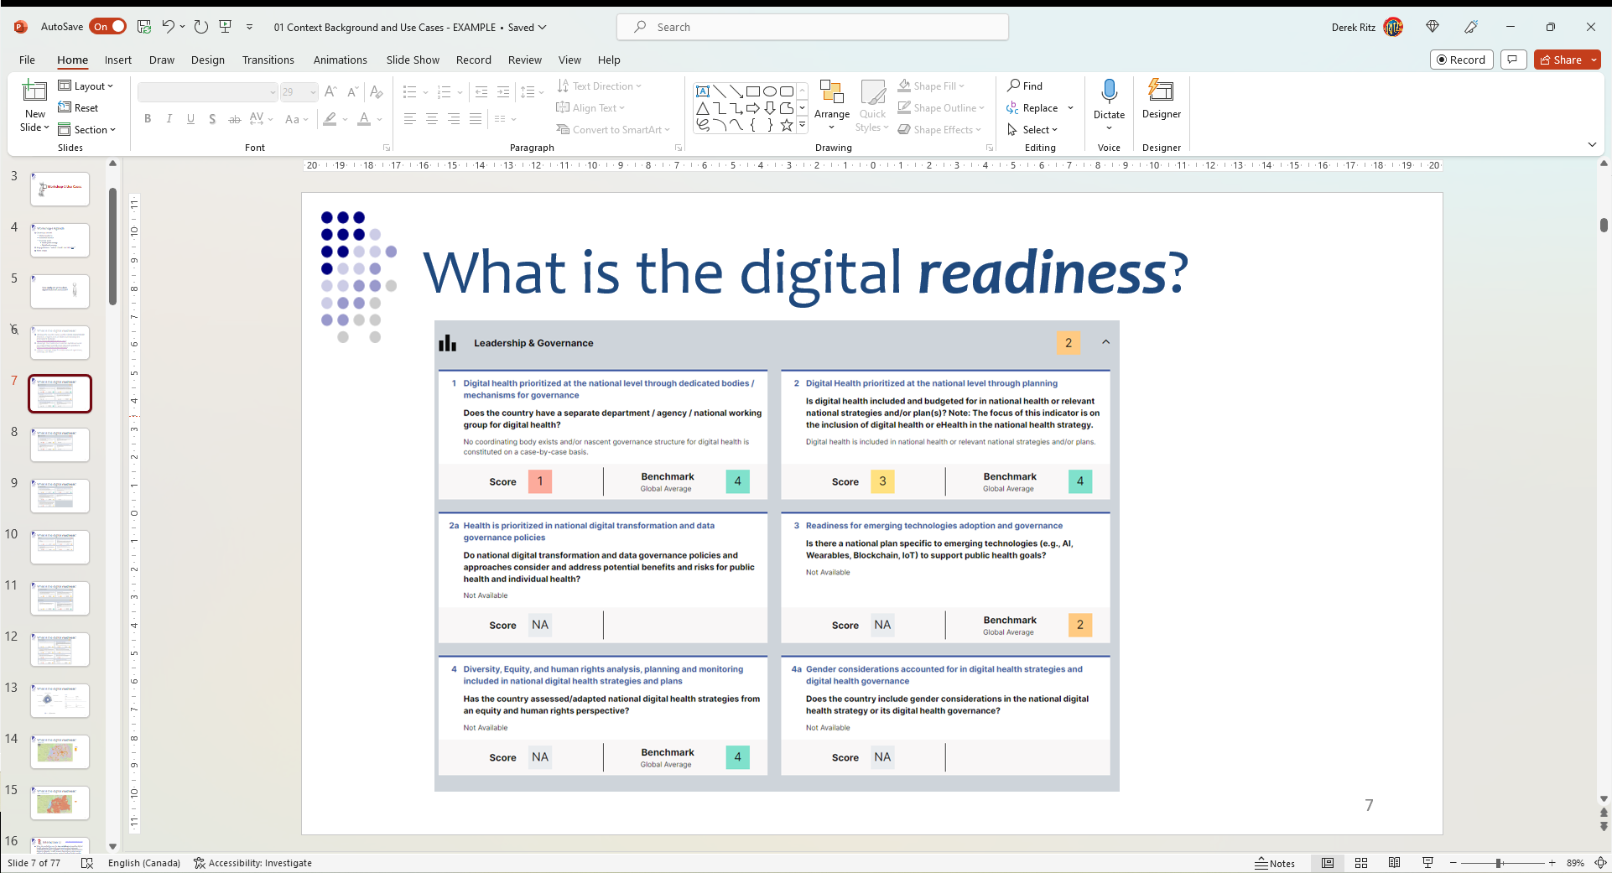


Slide 16
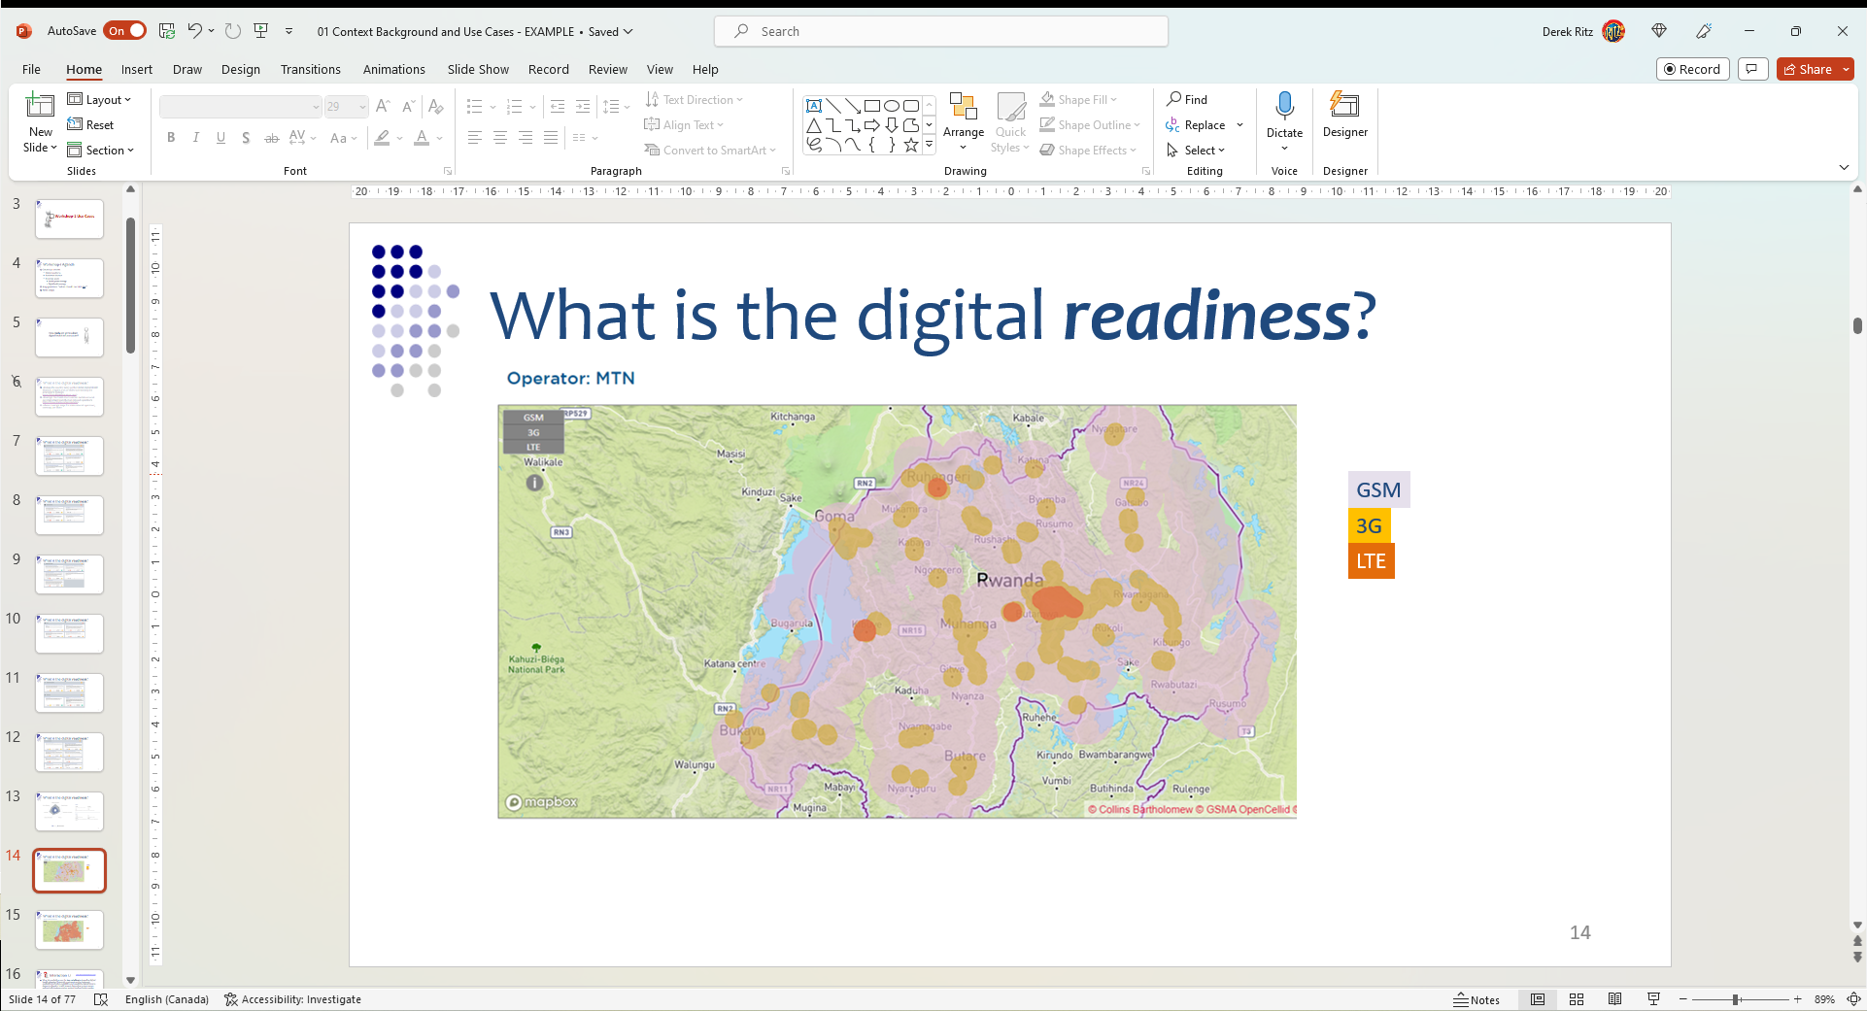

Slide 17
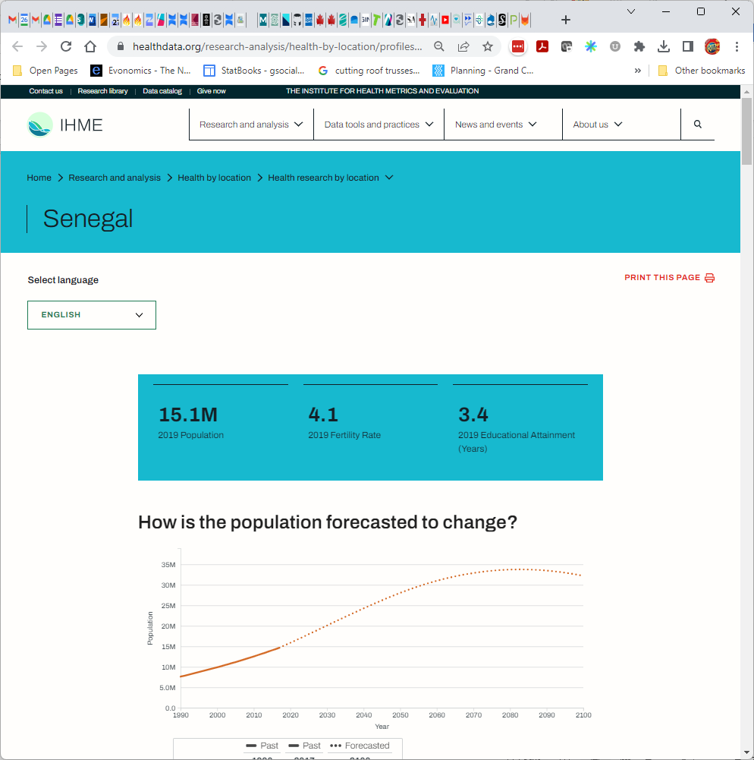

Slide 18
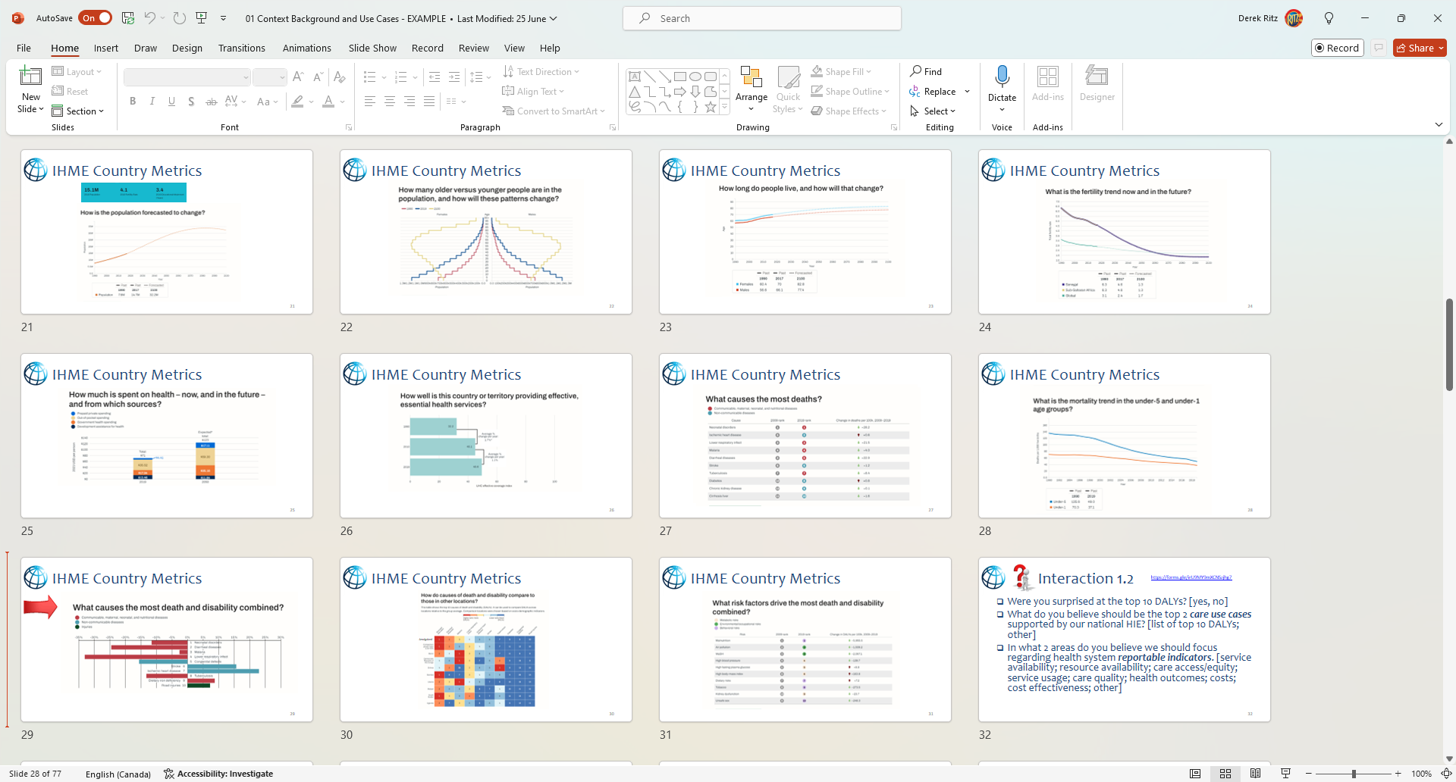

Slide 19
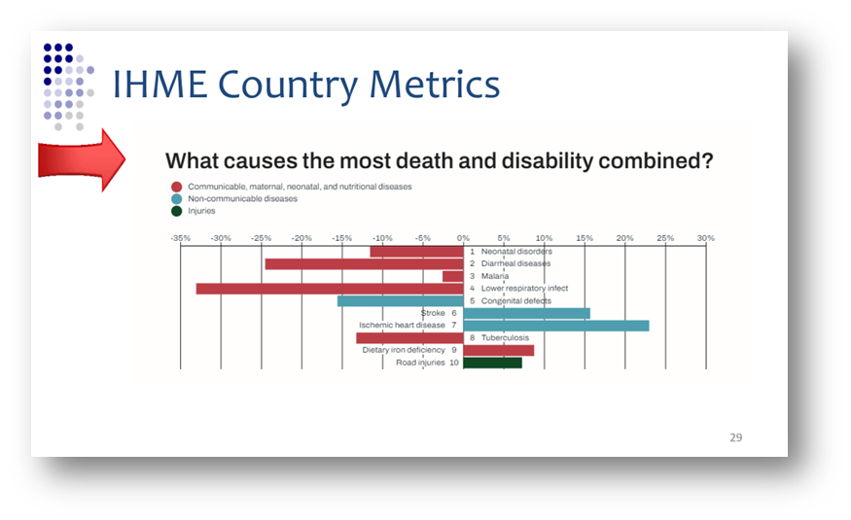

Slide 20
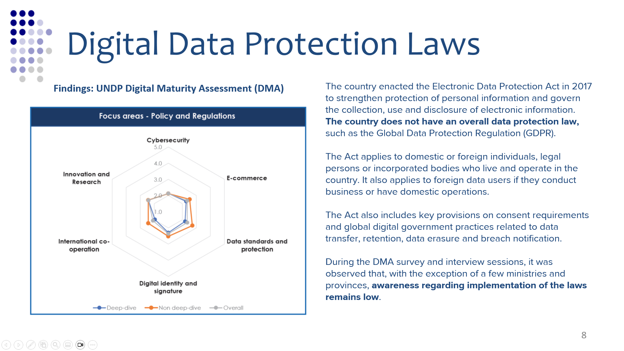

Slide 21
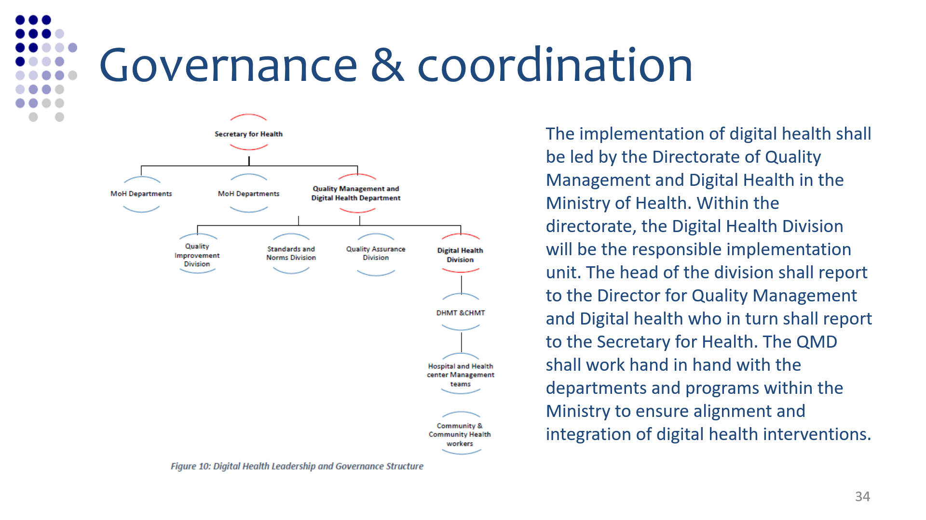

Slide 22
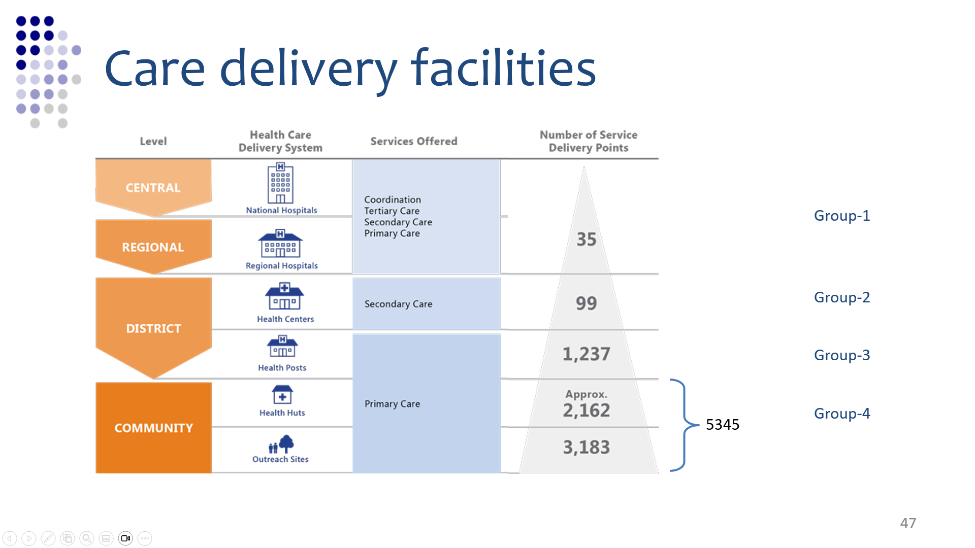

Slide 23
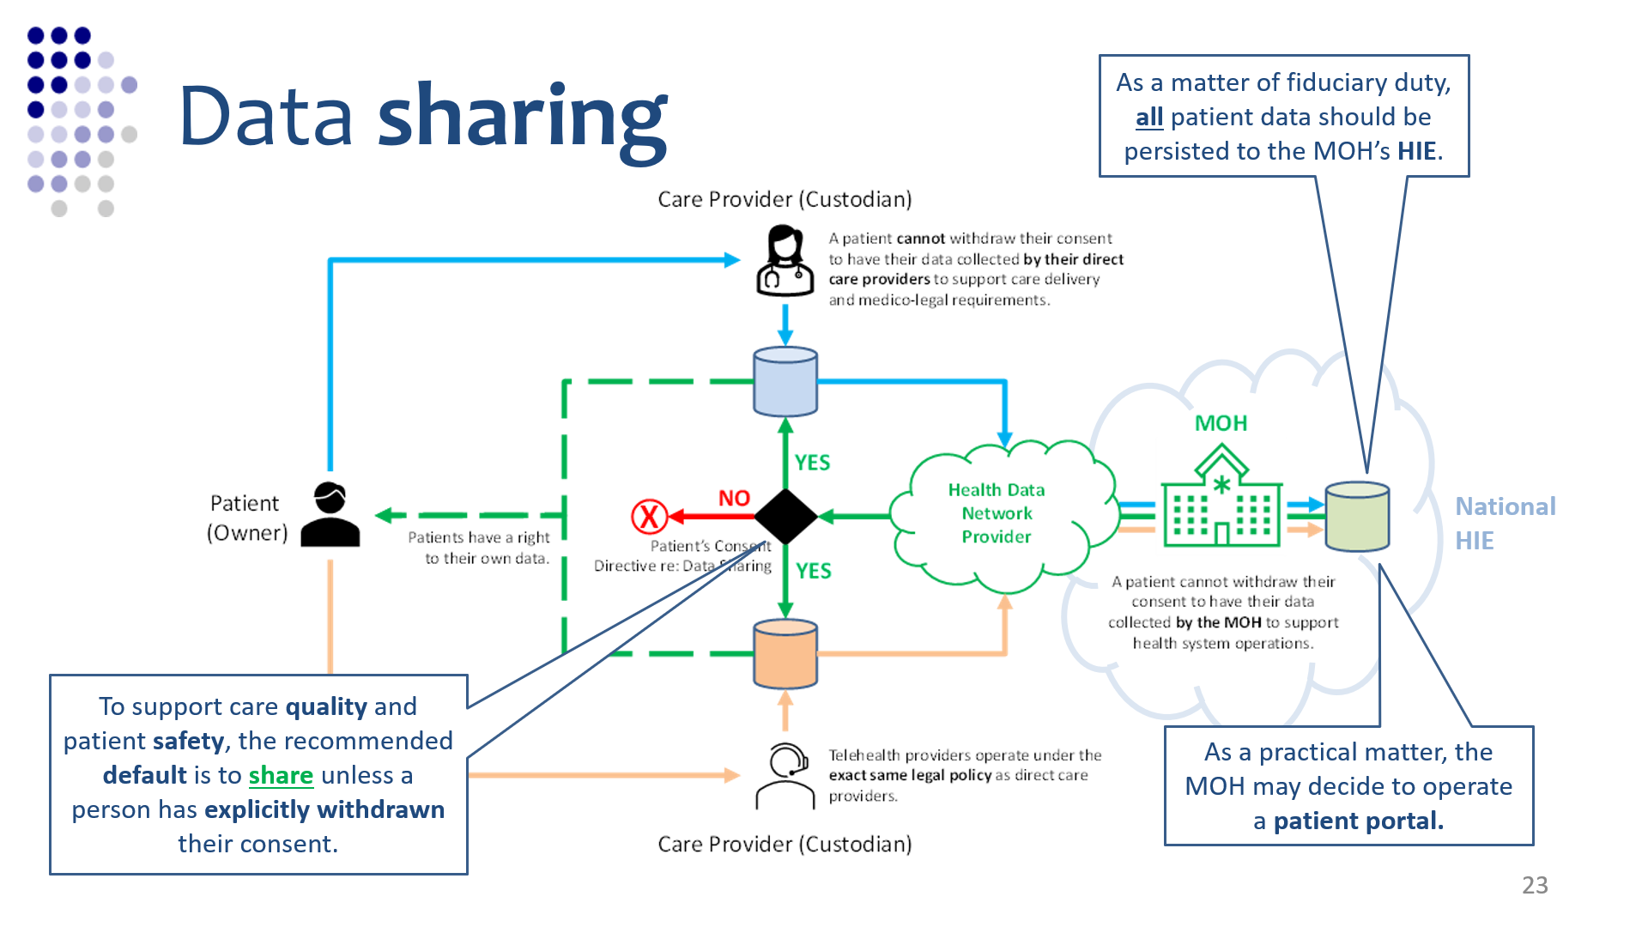

Slide 24
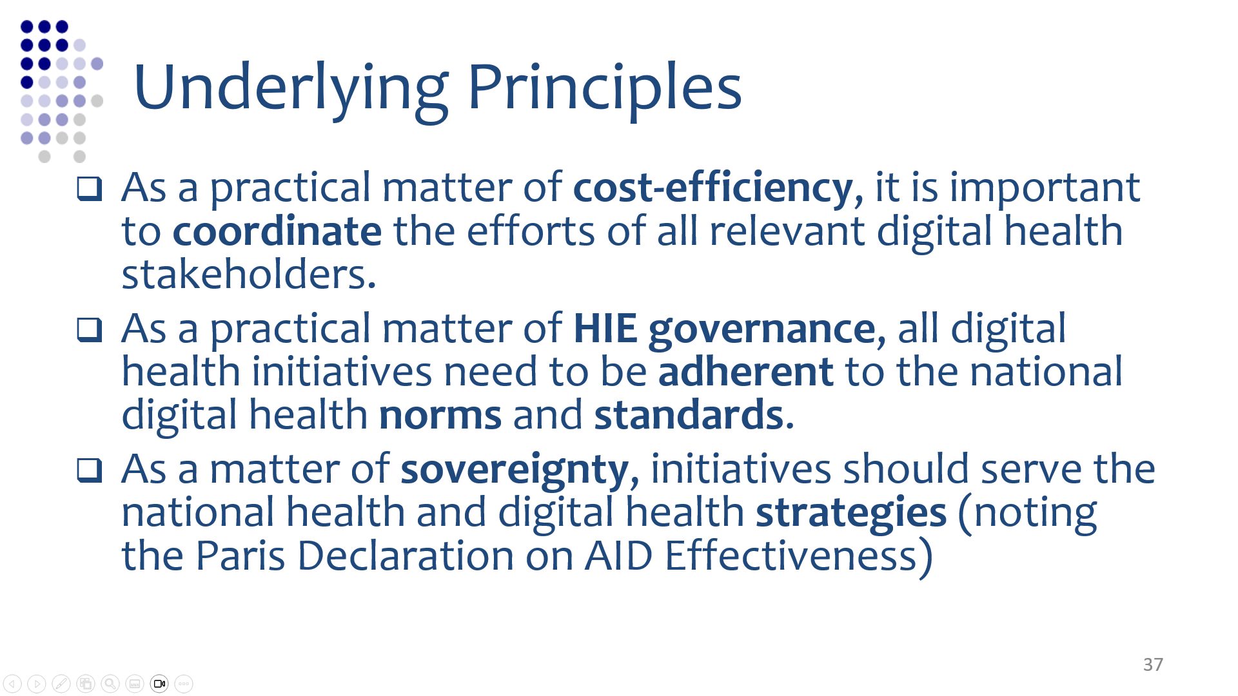

Slide 25
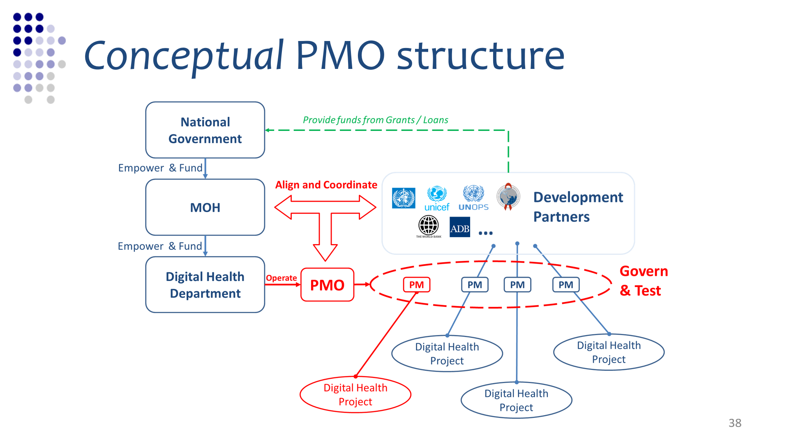

Slide 26
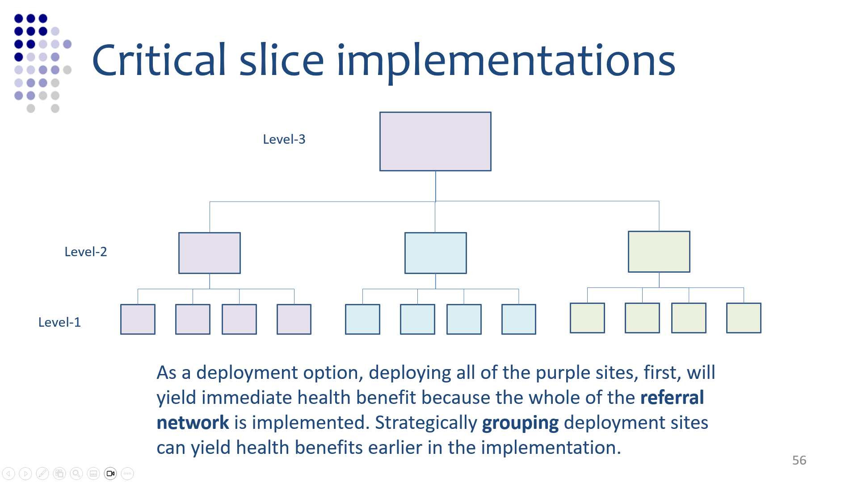

Slide 27
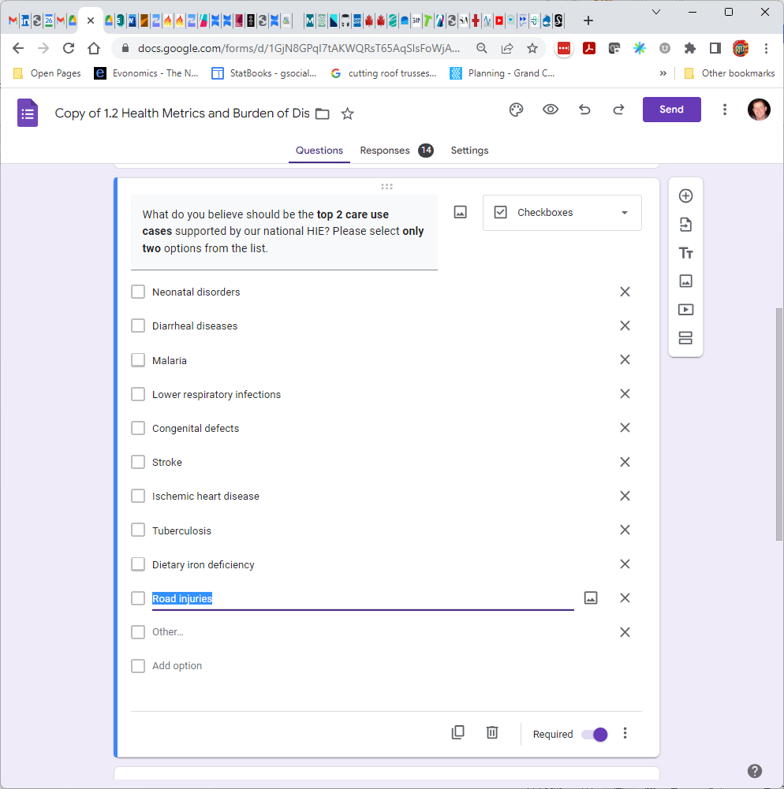

Slide 28
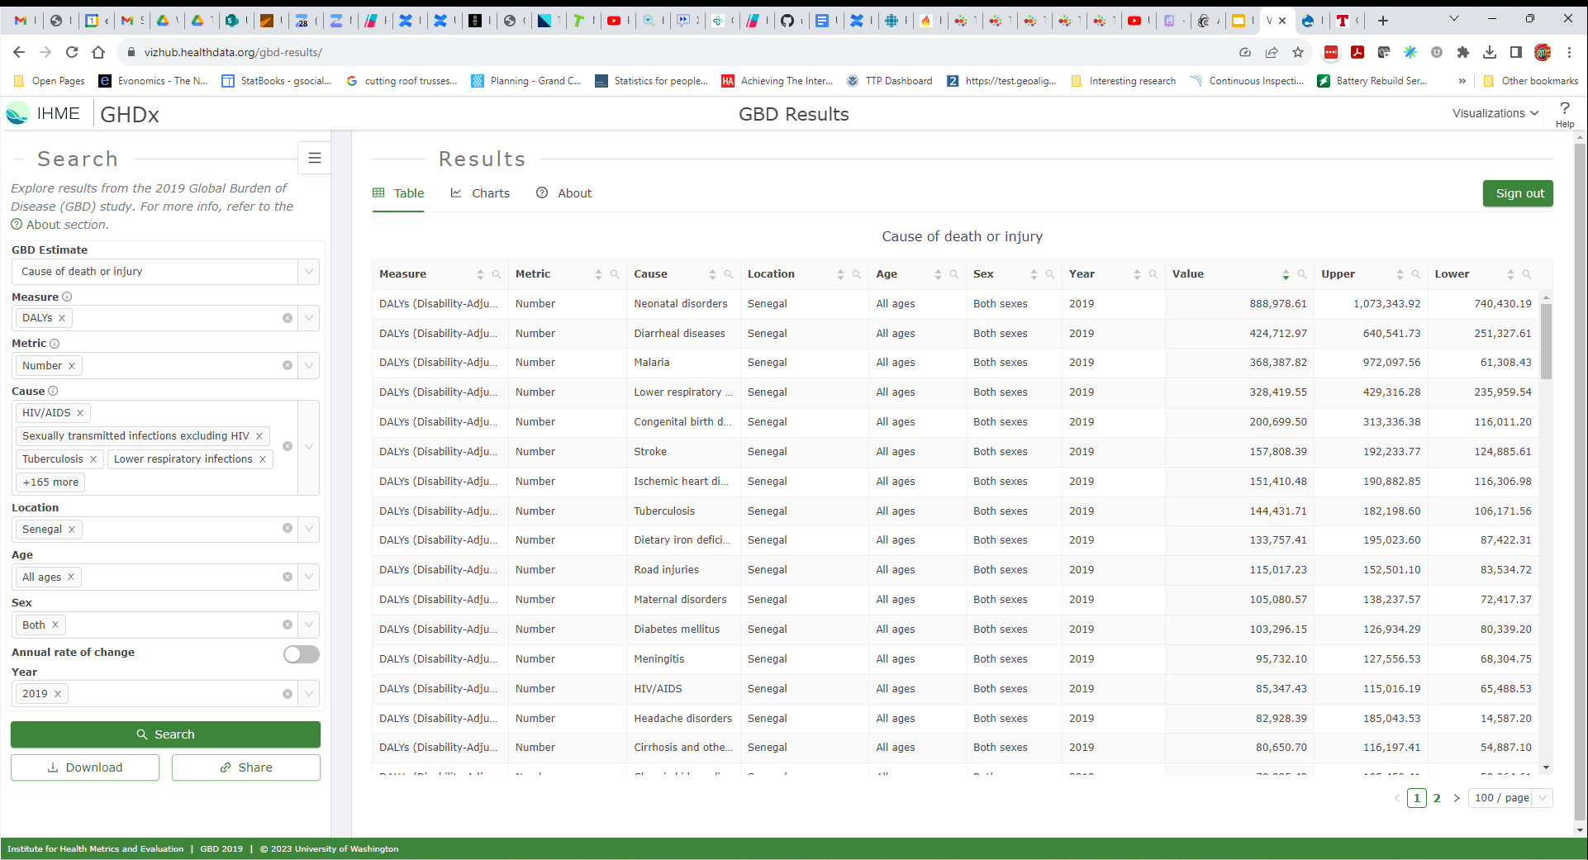
Amalgaland
Amalgaland
Amalgaland
Amalgaland
Amalgaland
Amalgaland
Amalgaland
Amalgaland
Amalgaland
Amalgaland
Amalgaland
Amalgaland
Amalgaland
Amalgaland
Amalgaland
Amalgaland
Amalgaland X

Slide 29
$
------------
Life-year
$
------------
Life-year
CET (annual GDP per capita):
Running total cost/QALY:
CET (annual GDP per capita)
---------------------------------------- :
Running total cost/QALY
$
------------
Life-year
Life-year
------------
$
*
= β
A country’s GDP is the economic value that results from the efforts of its population. The rate of economic value creation is one GDP per capita per year (dimensionally expressed as $ per life year).
Where the running total cost/QALY is lower than the CET, a life-year has been “purchased” for less than it is “worth” to the national economy. Each QALY gained will return one GDP per capita in value, and the economic return-on-investment (ROI) from this recovered life-year will be positive. How much ROI is reflected by the β metric. A β of 2 means the ROI is double the investment.

